Slide 1


Movie Recommender

Slide 2

Introduction
Do you sometimes feel like you are being listened to?
Does a Google search result in weeks of similar product suggestions?
You are not alone!
Targeted suggestions are a result of a predictive algorithm known as recommender systems
Notes:
Speaker: Mars

Slide 3

Objective
Recommender Systems aren’t always creepy
They can be useful
Power of goodness example: movie recommendation
Only watch movies with similar rating to your favourite movie! HELLLLOOO MACHINE LEARNING!
Notes:
Speaker: Sabina
Speaker: Mars ( Hello Machine Learning)

Slide 4



Dataset
Obtained from MovieLens
27,753,444 ratings by 283,228 users a cross 58098 movies
Data collection between January 1995 - September 2018
Data Inputs
userId
movieId
rating
movieId
title
genres
Notes:
Speaker: Sabina

Slide 5



Data Preparation
Clean the Data
Checked for null values
Merge Data Sets
Movies + Ratings on User ID
Feature Engineering
Created a dataframe for each movie and the number of ratings in order to calculate the correlation
Notes:
Speaker: Kevin

Slide 6


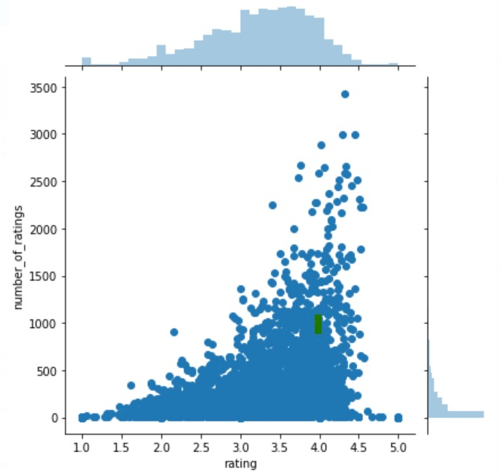
Modelling
Used seaborn plot to validate if the average rating is higher if the number of ratings is higher. A positive correlation was observed.
Notes:
Speaker: Kevin

Slide 7
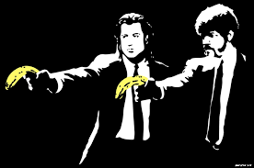
Modelling
A movie rating matrix was created logging users against the movie titles using the pandas pivot table functions.
Searched for our movie of interest = Pulp Fiction (1994)
Notes:
Speaker: Kevin

Slide 8
Modelling
Using the Corrwith() function, we looked for a correlation between Pulp Fiction ratings and the rating of the other movies in the dataset
It was hard to observe if movies with a high correlation rate (1.0) were actually good movies, so we looked at the correlation rate and the number of ratings
Highly correlated movies may have a low number of ratings
Notes:
Speaker: Kevin

Slide 9
Conclusion
Look at highly correlated movies that also had a high number of ratings and the result was more popular movies similar to Pulp Fiction
If you enjoy Home Alone but want a new holiday movie, we got your back!
CAST
EXECUTIVE PRODUCER KEVIN DE SOUSA
DIALOGUE EDITOR MARSILINO BILATOS
PROCESS EFFECTS SABINA MARTIN
STUNT DOUBLE MUHTASIM MALEQUE
Notes:
Speaker: Sabina Speaker: Mars

